Slide 1
Spring Boot Micro Services

Slide 2
MicroServices
Microservices - also known as the microservice architecture - is an architectural style that structures an application as a collection of services that are
Highly maintainable and testable
Loosely coupled
Independently deployable
Organized around business capabilities
Owned by a small team

Slide 3
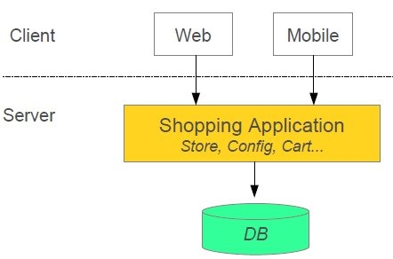
Monolithic Application

Slide 4
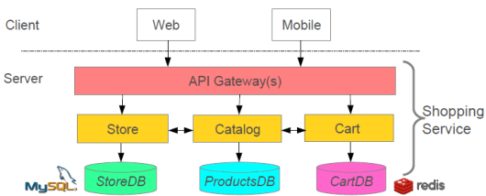
With Microservices

Slide 5
SOA vs Micro services
Service-oriented architecture (SOA) is a method of software development that uses software components called services to create business applications.
Each service provides a business capability, and services can also communicate with each other across platforms and languages
For example, multiple business processes in an organization require the user authentication functionality. Instead of rewriting the authentication code for all business processes, you can create a single authentication service and reuse it for all applications
A microservices architecture is considered an outgrowth of SOA. It also breaks down large-scale applications into smaller, more flexible components — but does so with even more granularity. It also organizes each unit around a specific, highly specialized business function
The main difference between SOA and microservices has to do with the architecture scope. In an SOA model, services or modules are shared and reused enterprise-wide, whereas a microservice architecture is built on individual services that function independently. In other words, SOA has an enterprise scope, while microservices has an application scope.

Slide 6
MicroService Principles
High cohesion, low coupling
Discrete Boundaries – each microservice designed to perform one task
Single Responsibility principle – A microservice should be responsible for only one task (easy to maintain)
Design for Failure - This allows the other services to continue functioning normally even if one service is down. Failure of one service will not impact the other services
Business Capabilities - Each service should be responsible for a specific business capability, and all of the services together should be able to cover all of the necessary business capabilities for full application

Slide 7
MicroService Principles
Decentralization - each service maintains its database and runs on its own server
Process Automation - Automate the deployment process of the microservices-based application. Adapt to DevOps and using the tools, such as Azure DevOps or Jenkins.
Service Communication - Use an event-based approach where one service publishes an event that another service can subscribe to and react accordingly. Another option is to use a messaging protocol to exchange messages without requiring any knowledge about their implementation details
Monitoring – Use an automated monitoring system that can track performance constatntly
Manage Traffic – Each service has its own volume of traffic. Developers should take advantage of auto-scaling and circuit breaker patterns in this regard

Slide 8
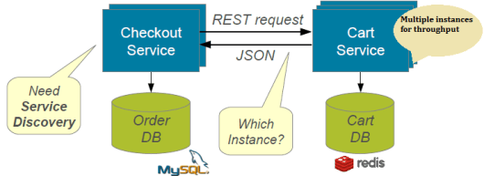
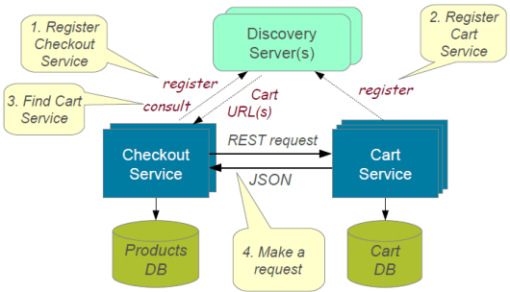
Discovery Service
Services should be able to discover each other

Slide 9
Spring cloud Micro Service Support
New service can be created using Spring Boot
Expose resources via RestController
Consume remote services using RestTemplate
Spring cloud support
Netflix Eureka Discovery Service
Netflix Ribbon / Cloud LoadBalancer for custom load balancing
Netflix Zuul for reverse proxy
Netflix Feign client abstraction to service calls
……… Many others

Slide 10
RestTemplate example
String customerUrl = "http://localhost:8081/customers/{id}";
String productUrl = "http://localhost:8082/products/{id}";
RestTemplate template = new Resttemplate();
Customer customer = template.getForObject(customerUrl, Customer.class, customerId);
Product product = template.getForObject(productUrl, Product.class, productId);

Slide 11
Feign Client
a declarative HTTP client developed by Netflix.
Feign aims at simplifying HTTP API clients
the developer needs only to declare and annotate an interface while the actual implementation is provisioned at runtime
Dependency:
<dependency>
<groupId>org.springframework.cloud</groupId>
<artifactId>spring-cloud-starter-feign</artifactId>
</dependency>

Slide 12
Feign Client – How To
Enable FeignClients
@SpringBootApplication
@EnableFeignClients
public class BookServiceApplication {
public static void main(String[] args) {
SpringApplication.run(BookServiceApplication.class, args);
}
}

Slide 13
Feign Client – How To
Create interface annotated with @FeignClient
Declare methods of the microservice which you want to access
@FeignClient(name="BookFeign", url = "http://localhost:8081/books")
public interface BookFeignClient {
@GetMapping("{id}")
public Book getBook(@PathVariable("id") int bookId);
}

Slide 14
Feign Client – How To
Autowire this interface and call the methods
public class BookDataController {
String bookUrl = "http://localhost:8081/books/{id}";
@Autowired
BookFeignClient fc;
@RequestMapping("{bookId}")
public Book getBookData(@PathVariable int bookId) {
Book b = fc.getBook(bookId);
Return book;
}

Slide 15
Eureka Server
Eureka Server is Netflix discovery service
Eureka server is in turn a Eureka client
Eureka Clients have to register with EurekaServer so that they can be discovered
Eureka Clients send heartbeat in fixed interval to show that they are up and running
If heartbeat is not received, Eureka Server removes the service from registry
Eureka Clients may fetch the registry to know the list of microservices available

Slide 16
Create Eureka Server
Create a spring boot starter project with the following dependencies
Eureka server
Web
Use @EnableEurekaServer on the application class
Provide the following properties
server.port=8761 (default for eureka server)
eureka.client.register-with-eureka=false
eureka.client.fetch-registry=false
Access with url http://host:8761/eureka

Slide 17
Eureka Client
Eureka clients are discoverable through eureka server
Create a spring boot starter project with the following dependencies
Eureka client
Web
Use @EnableDiscoveryClient or @EnableEurekaClient
Provide the following properties
server.port=8082
Spring.application.name=servicename
eureka.client.fetch-registry=false
eureka.client.serviceUrl.defaultZone = http://localhost:8761/eureka
(above property not required if eureka server runs on 8761)

Slide 18
Spring cloud DiscoveryClient
Spring cloud provides DiscoveryClient which can be used to identify service instances
We can use this interface (autowired) to get details of registered services
interface org.springframework.cloud.client.discovery.DiscoveryClient
Methods:
List<ServiceInstance> getInstances(Sting serviceId)
List<String> getServices()

Slide 19
Load Balancing
Netflix provides Ribbon as client side load balancer for multiple instances of the same service
Use RestTemplate for basic load balancing
@LoadBalanced
@Bean
RestTemplate getRestTemplate() {
return new RestTemplate();
}
Configure Ribbon for Customized load balancing

Slide 20
Ribbon – Load Balancer
Netflix Ribbon is a cloud library which primarily provides client-side load balancing algorithms.
Apart from the client-side load balancing algorithms, Ribbon provides also other features:
Service Discovery Integration – provides service discovery in a cloud environment. Integration with Eureka Discovery
Fault Tolerance – Dynamically determine whether the services are up and running or down
Configurable load-balancing rules – Ribbon supports RoundRobinRule, AvailabilityFilteringRule, WeightedResponseTimeRule and also supports defining custom rules

Slide 21
Ribbon Configuration
Ribbon allows to configure the following components of the load balancer:
Rule – Logic component which specifies the load balancing rule
Ping – Component which specifies the mechanism to determine the server's availability in real-time
ServerList – can be dynamic or static
Static – define in properties or yml
Dynamic -

Slide 22
Ribbon Default Configuration
Netflix provides default implementation classes for load balancing with Ribbon
IClientConfig ribbonClientConfig: DefaultClientConfigImpl
IRule ribbonRule: ZoneAvoidanceRule
IPing ribbonPing: NoOpPing
ServerList<Server> ribbonServerList: ConfigurationBasedServerList

Slide 23
Ribbon Custom Configuration
Create Configuration class
public class RibbonConfiguration {
@Autowired
IClientConfig config;
@Bean
public IPing ribbonPing(IClientConfig config) {
return new PingUrl();
}
@Bean
public IRule ribbonRule(IClientConfig config) {
return new AvailabilityFilteringRule();
}
}

Slide 24
Ribbon Main class
Ribbon Project Main class
@SpringBootApplication
@RibbonClient(name = "ribbon-client",configuration = RibbonConfiguration.class)
public class RibbonApplication {
public static void main(String[] args) {
SpringApplication.run(RibbonApplication.class, args);
}
}

